Slide 1

Team Name : Parkar
Team Leader Name : Sridhar Sathyanarayanan
Problem Statement : AI for Rural Innovation & Sustainable Systems

Slide 2

Brief about the Idea:
AI Smart Sarkar Form Assistant is a mobile solution that simplifies government form access for rural citizens by reading, interpreting, and explaining forms in local languages. Through a voice‑based conversational flow, it collects user inputs, validates details, auto‑fills forms, and provides document checklists—even in low‑network areas.
- Mobile-first solution designed for rural citizens to access government services easily.
- Reads and interprets any uploaded form, not limited to fixed templates.
- Explains fields in simple local languages through text and voice.
- Guides users via conversational Q&A, collecting inputs naturally.
- Validates information to prevent errors, rejections, and delays.
- Auto‑fills official forms with user responses.
- Generates a personalized document checklist for smooth submission.
- Supports offline use and low‑network environments, syncing when possible.
- Shares completed forms via WhatsApp/email or applies directly to portals.
- Removes language and literacy barriers, empowering rural communities.
- Saves time, travel costs, and dependency on agents, enabling digital inclusion.
- Promotes sustainable governance by bridging citizens and government services.

Slide 3
Your solution should be able to explain the following:
How it’s different from existing solutions
Most current tools rely on fixed templates or basic text extraction.
Your solution goes further: it understands any government form dynamically, explains it in regional languages, and supports voice-based interaction even in low-connectivity rural areas.
Unlike existing apps, it doesn’t just digitize forms—it guides users conversationally and can even apply on their behalf or share completed forms via WhatsApp/email.
How it solves the problem
Language barrier removed: Explains forms in simple Hindi, Marathi, Tamil, Telugu, etc.
Literacy barrier removed: Voice assistant guides users step by step.
Error reduction: Smart validation prevents mistakes (e.g., Aadhaar/PAN format, age mismatches).
Accessibility: Works offline or with low bandwidth, reducing dependency on agents or repeated office visits.
USP (Unique Selling Proposition)
An AI-powered voice assistant that can:
Read and explain any government form.
Auto-fill forms via conversational Q&A.
Operate in regional languages and offline mode.
Tailored for rural India, where literacy and connectivity challenges are most acute.

Slide 4
List of features offered by the solution
AI Form Understanding: Reads any government form (PDF/photo) and identifies fields, instructions, and required documents.
Local Language Explanation: Explains every field in simple Hindi/Marathi/Tamil/Telugu/etc. using clear text + optional voice.
Conversational Q&A Form Filling: Asks the user simple voice/text questions and auto-fills the form based on their responses.
Smart Validation: Checks Aadhaar/PAN format, age mismatches, missing fields, and eligibility issues.
Auto-Fill & Export: Generates a complete, ready-to-submit filled form (PDF/printable output).
Low-Network / Offline Support: Works even with poor connectivity ideal for rural areas.
Document Checklist Generator: Creates a list of required proofs (address, income, ID) based on the form type.
Step-by-Step Submission Guide: Provides clear instructions on where and how to submit forms (Panchayat, Tehsil, online portal, etc.).

Slide 5
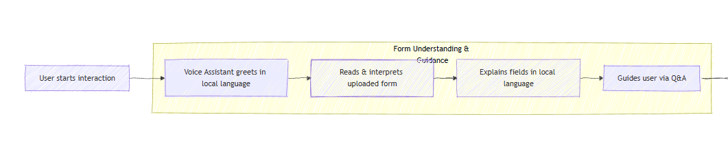
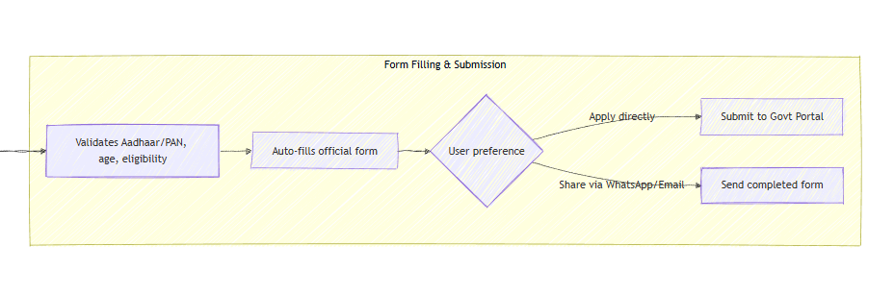
Process flow diagram or Use-case diagram

Slide 6
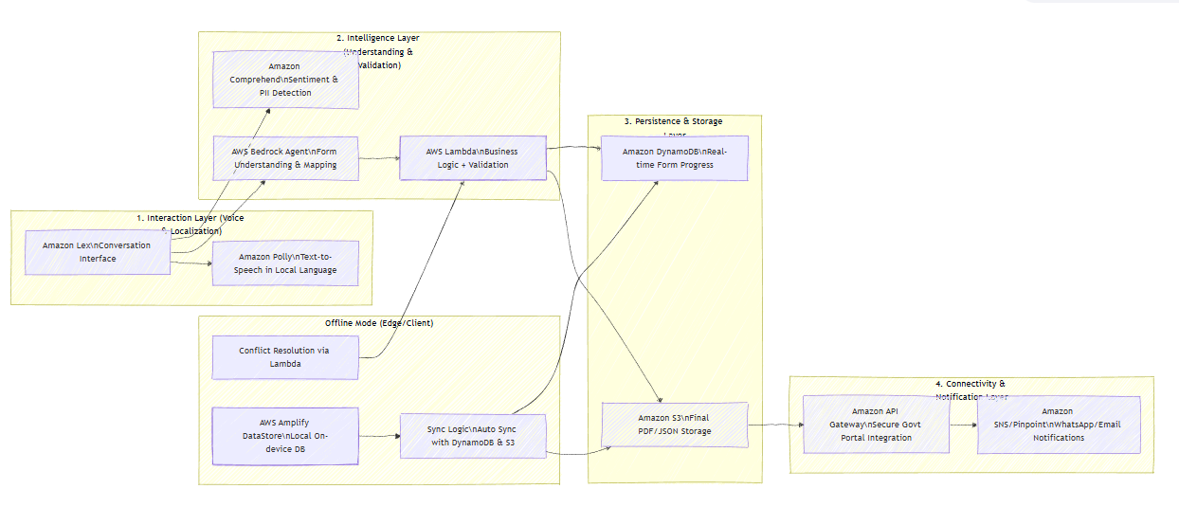
Architecture diagram of the proposed solution:

Slide 7
Technologies to be used in the solution:
1. The Interaction Layer (Voice & Localization)
Amazon Lex: Acts as the primary interface, managing the conversation state (intents and slots).
Amazon Polly: Provides the "voice" of the system, converting text back to speech in the user's local language to maintain the conversational loop.
2. The Intelligence Layer (Understanding & Validation)
Amazon Comprehend: Analyzes the user's input for sentiment or PII (Personally Identifiable Information) detection.
AWS Bedrock Agent: This is the "brain." It uses Foundation Models to explain complex form fields to the user in simple terms and maps unstructured speech to specific form fields.
AWS Lambda: The glue. It triggers Bedrock, handles the business logic, and performs regex-based validation for Aadhaar and PAN formats before data is committed.
3. The Persistence & Storage Layer
Amazon DynamoDB: Stores real-time form progress. Because it's NoSQL, it handles partial form saves easily.
Amazon S3: Once the Lambda confirms the form is complete, it generates a final PDF/JSON document and stores it here.
4. The Connectivity & Notification Layer
Amazon API Gateway: Serves as the secure egress point to push the validated data into external Government Portals.
Amazon SNS / Pinpoint: Handles the multi-channel notification (WhatsApp/Email) once the submission is successful.

Slide 8
Estimated implementation cost (optional):

Slide 9
Add as per the requirements for the hackathon:

Slide 10


